Slide 1
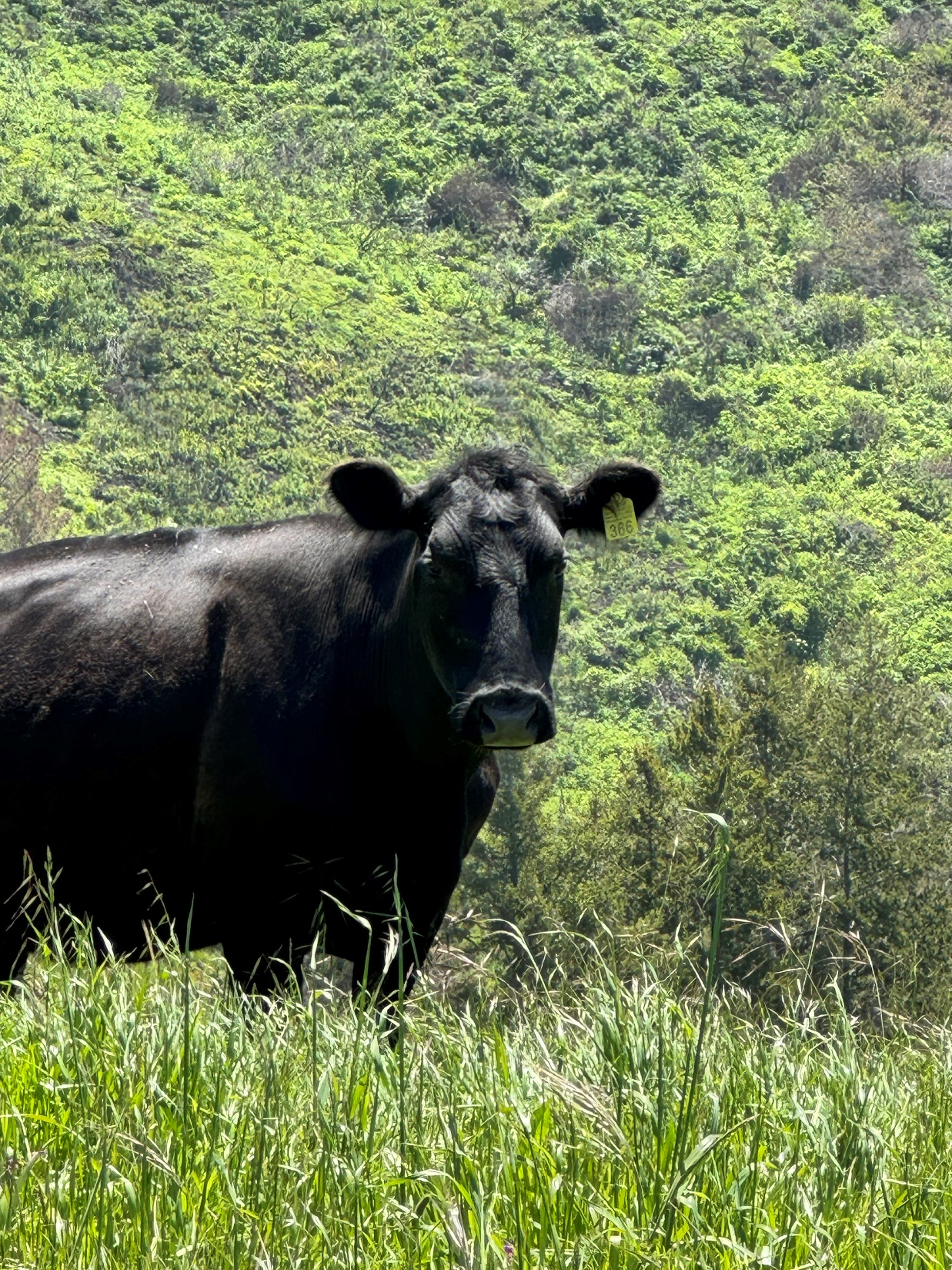
How California is Creating a Pathway to Reduce Dairy Methane
Joint Hearing:
How Agricultural Programs Have Made Use of Cap-and-Invest Funds
Ermias Kebreab
Associate Dean
Sesnon Endowed Chair
Professor of Sustainable Agriculture
University of California, Davis
Notes:
Good morning Chair and members of the committee.
My name is Ermias Kebreab. I am a professor at UC Davis working on sustainable livestock systems and methane mitigation.
California has taken global leadership in reducing methane from agriculture.
Today I will briefly highlight how California’s incentive programs, supported through Cap-and-Invest funding, are helping the dairy sector move toward the state’s methane reduction goals.

Slide 2
The Challenge
Notes:
The dairy sector is particularly important because it accounts for roughly 45 percent of the state’s anthropogenic methane emissions, which is why it is central to achieving California’s climate goals.
In 2016, California passed SB 1383, which established a goal of reducing methane emissions from livestock and dairy by 40 percent by 2030. Importantly, the state chose an incentive-based strategy rather than imposing immediate regulations on farms. Through programs supported by Cap-and-Invest revenues, producers receive support to adopt technologies that reduce methane emissions.

Slide 3
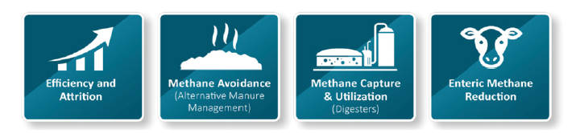
How Programs are Reducing Dairy Methane
Notes:
California’s progress comes from combining several mitigation strategies. First, improvements in productivity allow dairies to produce the same amount of milk with fewer animals, reducing overall emissions intensity. Second, alternative manure management systems reduce methane formation by changing how manure is handled on farms. Third anaerobic digesters capture methane from manure and convert it into renewable natural gas, preventing emissions while producing energy. Finally, emerging enteric methane mitigation technologies, such as feed additives, reduce methane produced during digestion. These strategies are complementary, and together they form a comprehensive pathway for methane reduction in the dairy sector.

Slide 4
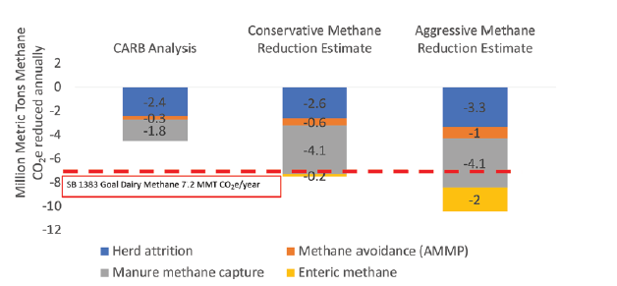
The Progress
Notes:
Let me walk through the four pathways driving these reductions.
First, herd efficiency. California has gone from 1.84 million cows in 2008 to 1.70 million in 2023, while milk production per cow has increased dramatically. This accounts for 2.6 to 3.3 million metric tons—nearly 30% of our goal.
Second—and this is critical—anaerobic digesters. Our analysis found 227 digesters either operating or actively being developed as of August 2023. CARB's analysis only counted 111—those funded through CDFA's digester program. They missed an additional 116 privately developed projects. This alone represents 4.1 million metric tons in annual reductions—the single largest contributor to meeting the goal.
Third, alternative manure management through CDFA's AMMP program—composting, solid separation, and other practices—contributes another 0.6 to 1.1 million metric tons.
Finally, enteric feed additives like 3-NOP—which will be FDA-approved this year—offer 0.2 to 2 million metric tons depending on adoption rates. While still emerging, these provide the final piece to not just meet but exceed our targets."

Slide 5
The Role of Cap-and-Invest Incentives
Without Cap-and-Invest funding, this progress would not be possible
Critical Incentive Programs:
DDRDP (Dairy Digester Research & Development): Capital cost grants
AMMP (Alternative Manure Management): Smaller-scale solutions
LCFS, Cap-and-Trade Offsets: Revenue streams for operations
Notes:
This success is directly attributable to California's Cap-and-Invest program. Dairy digesters cost millions of dollars to build and operate. Without CDFA's capital grants through DDRDP and ongoing revenue streams from programs like the Low Carbon Fuel Standard, Cap-and-Trade offsets, these projects simply would not pencil out financially for dairy farms. The AMMP program has been equally critical for smaller operations where digesters aren't economically feasible—providing pathways for composting, solid separation, and other practices. California's incentive-based model is proving that environmental goals and agricultural viability can go hand-in-hand.

