Slide 1
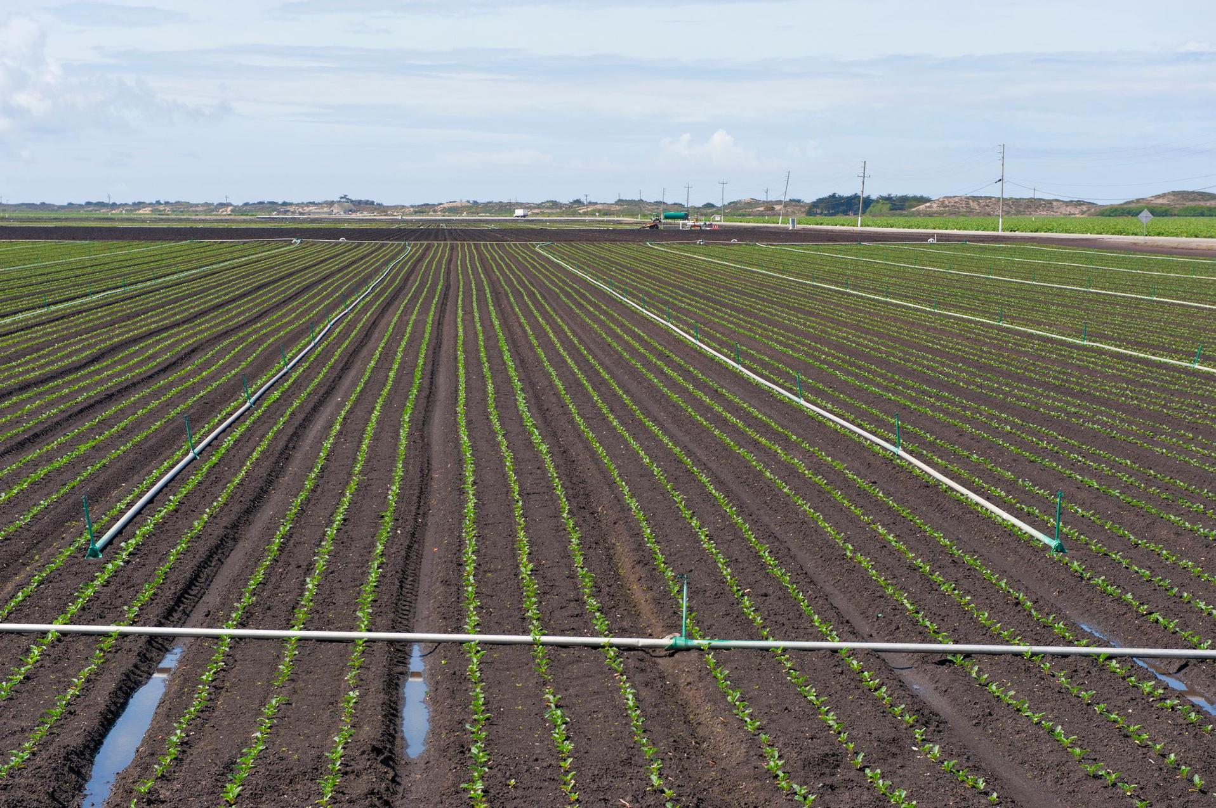

Multi-Benefit Agricultural Climate Solutions
Brian Shobe, Policy Director
March 17, 2026

Slide 2
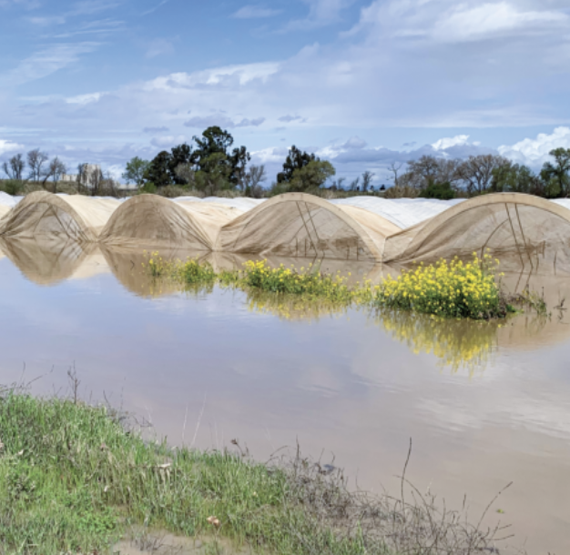
Rising Input Costs
Fertilizer, energy, water, and labor costs
are at all-time highs
Rising Climate Risks
Droughts and floods now regularly cost billions of dollars in the CA ag economy
Rising Food Prices
Climate change is already contributing to food price inflation

Slide 3
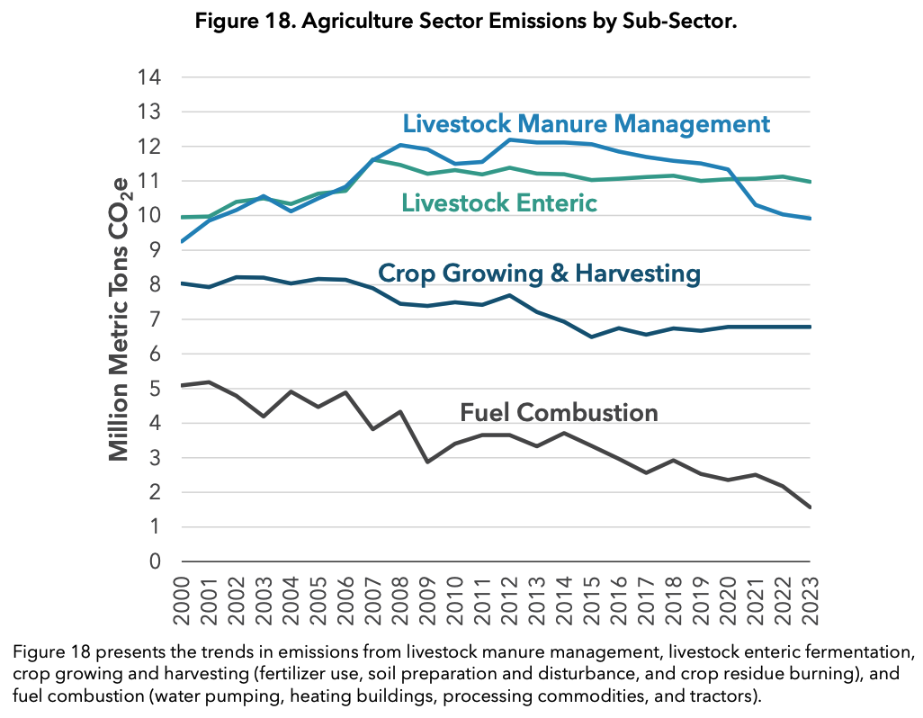




State Targets
CA Agriculture Sector Emissions (2000-2023)
Reduce manure methane 40% by 2030 (SB 1383)
Increase healthy soils practices by 3.1 million acres by 2045 (AB 1757)
Increase organic acreage to 20% by 2045 (AB 1757)
Electrify 75% of ag energy use by 2045 (Scoping Plan)
Source: CARB

Slide 4
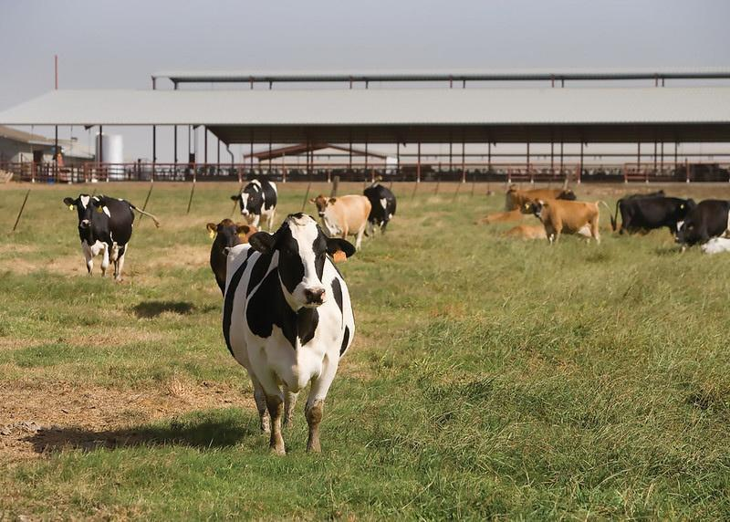
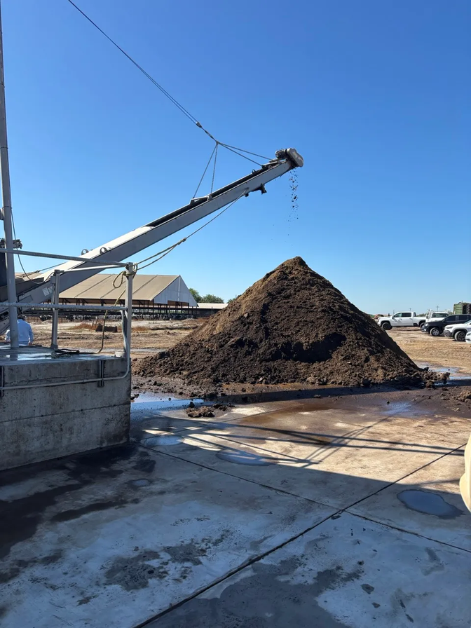

Alternative Manure Management Program (AMMP)
Methane
Water Quality
Compost
Reduces manure
methane by up to
80 percent
Helps dairies comply with water quality regulations (Dairy Order & ILRP)
Two-thirds of AMMP
projects convert manure
to compost

Slide 5
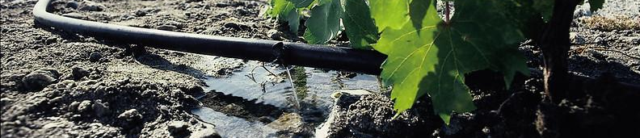
State Water Efficiency & Enhancement Program (SWEEP)
N₂O & CO₂
Water & Energy
Air Quality
Reduces both nitrous oxide and carbon dioxide
emissions
Reduces water and energy bills by thousands of dollars
per year
Improves air quality by
electrifying diesel
irrigation pumps

Slide 6
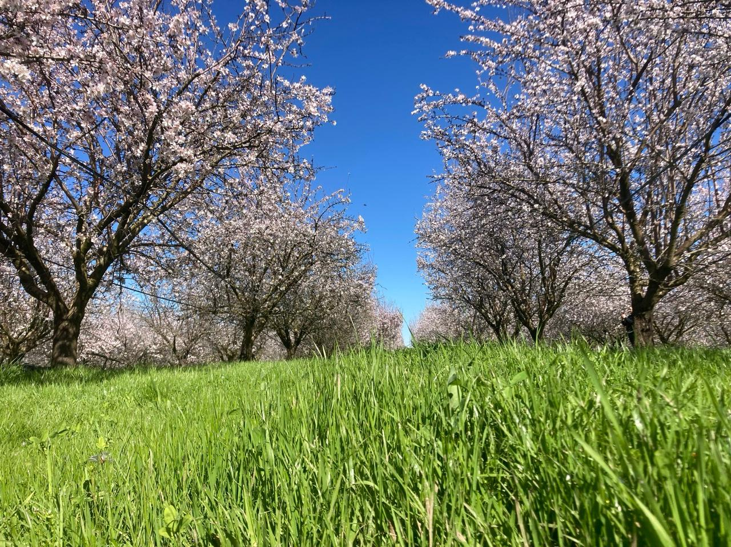
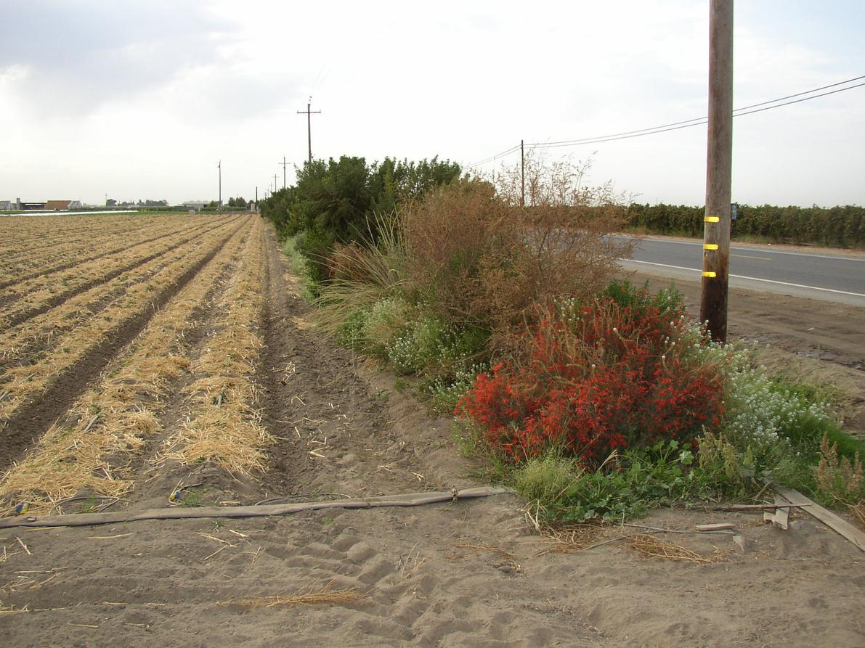
Healthy Soils Program (HSP)
Carbon
Water
Biodiversity
Reduces soil carbon loss and increases carbon storage above and below ground
Increases soil water infiltration and retention, reducing flood & drought risks
Increases habitat for
pollinators, birds, and
beneficial insects

Slide 7
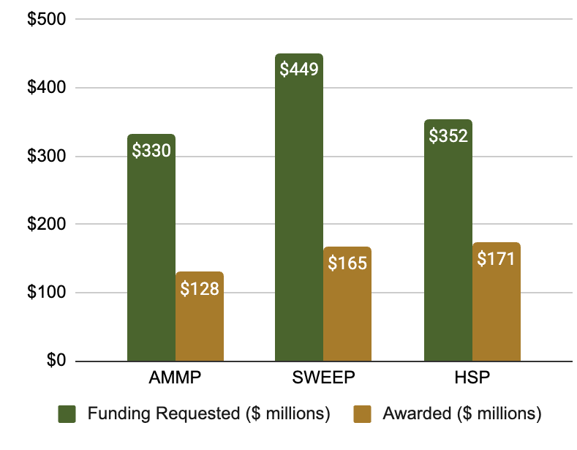
Evaluation Results
Climate Smart Agriculture
Program Demand vs Amount Awarded (2014-2025)
Farmers continue practices
Vast majority of participants intend to continue new practices after grant ends
Practices increased resilience
3 out of 4 participants indicated their farm is more resilient with new practices
Projects inspired other farmers
Over half of participants felt their project had significant impact on practice adoption by other farmers
Source: Babin et al (2024)

Slide 8
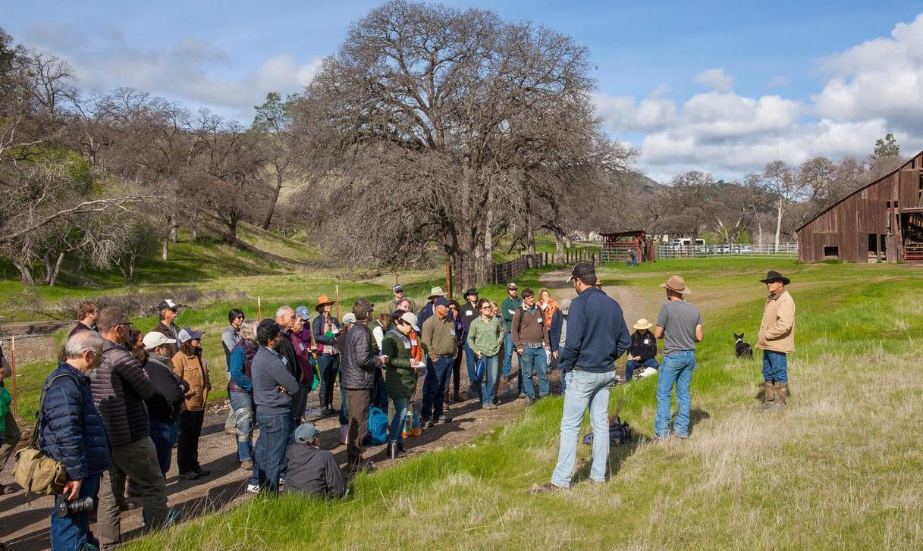

Brian Shobe, Policy Director
brian@calclimateag.org
www.calclimateag.org

